Slide 1

Scrum-Agile Approach
By: Chloe Ninefeldt

Slide 2
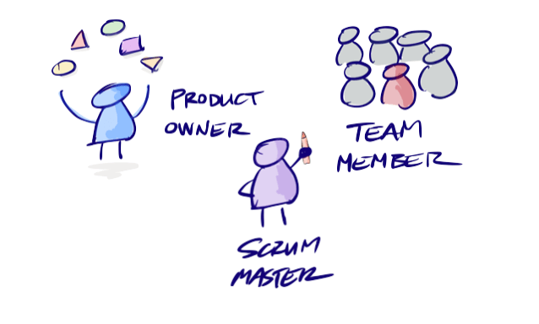
Roles on a Scrum-agile Team
Product Owner:
In charge of the product backlog items and to make sure the development team understands the product backlog fully
Scrum Master:
Making sure Scrum is fully understood and enforces scrum theory, practices, and rules
Team:
Create increments and are the ones who do the work of delivering a “Done” product at the end of each sprint
Notes:
There are essentially three roles on a Scrum-agile team. First one I want to go over is the product owner, who is in charge of the product backlog. They are responsible for managing the product backlog and keeping in contact with the customer. Ensuring the team clearly understands the product backlog and to clarify anything to make it completely transparent. The product owner represents the customer/business and will direct the team on what needs to be done. The scrum master is responsible for making sure that scrum is understood. They make sure the team sticks to the theory, rules, and practices of scrum and helps the team understand the need to concise product backlog items. Scrum masters are also responsible for facilitating scrum events like the daily scrum meetings and coaching. The team (development team) are a group of professionals that work together on delivering a “Done” product at the end of a sprint. They are the only ones that can create increments and are very organized and manage their own work. Teams are cross-functional and recognizes that everyone is responsible and accountable throughout the project.

Slide 3
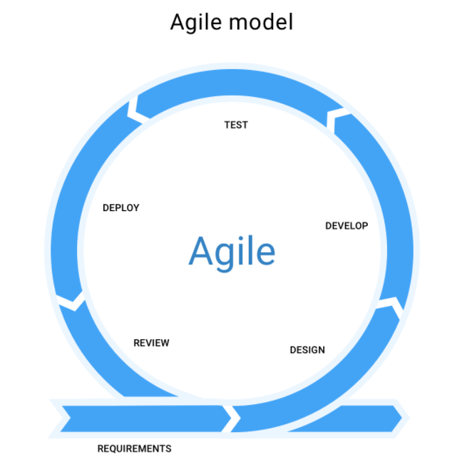
Phases of the SDLC Work in an Agile Approach
Requirements
Design
Develop
Test
Deploy
Review
Notes:
The first phase in an agile approach is to create initial documentation that will have the initial requirements. This includes what the project is going to achieve, what features it will support, and features that won’t be initially supported. The client and the product owner review these stated requirements and go over them before moving on to the next phase. Phase 2 is design; this is either visual and/or architectural. The product owner with gather their development team and then go over the requirements that were made in phase 1. They will discuss how they want to go about the requirements and what tools they can use to achieve those requirements. Phase 3 is the development phase where code is written, and the designs are converted into the software. Which then moves into phase 4 of testing. This phase is making sure the software/code works and is bug-free. The testers do a series of tests to make sure the code works properly, and the client's goals are met. Deployment is phase 5 and this is when the application is deployed on the servers and the customers are able to access it. Can be a demo or the real deal, but it should be working, nonetheless. The final phase is review, this is where the product owner will pull everyone together and go over the progress made towards completing the requirements made in phase 1. They discuss and problems and how to resolve them.

Slide 4
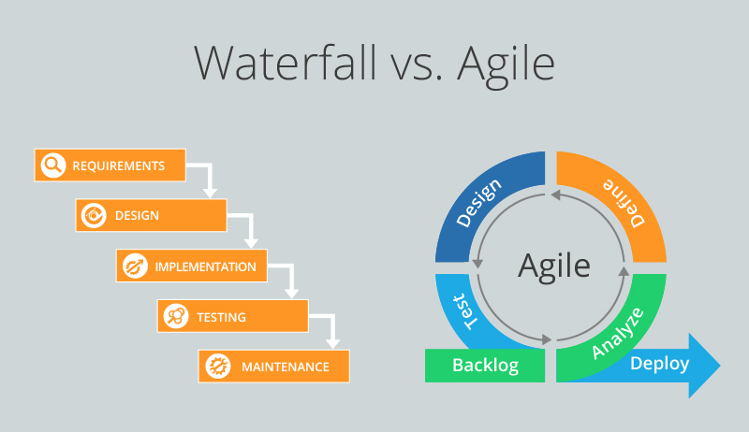
Waterfall vs Agile
When a waterfall project starts, all requirements are laid out in the very beginning and then when the project starts, it’s very rigid and hard to change anything. Agile is basically a mini collection of projects that are within one big project known as an epic. Agile is also much more flexible than waterfall. An example of this is when the SNHU Travel project took a turn. They wanted the vacation styles to be completely different as what was in demand changed. In an agile approach, this was no big deal whatsoever. It was frustrating, but very doable and the team can adapt to these changes. In a waterfall approach, we would have had to start all over. Change is not expected nor welcomed from what I understood about waterfall.

Slide 5
What to Consider…
Waterfall:
Requirements are understood
Customer/client isn’t prone to changes
Customer/client doesn’t want to be involved
The project isn’t very big
Delivery speed isn’t very important
Team members only know one role
Agile:
Requirements aren’t fully understood
Change is expected
Customer/client wants to be involved
Delivery speed is important
Management wants working software
Team members can do many things
Notes:
There are many things to consider when deciding to use a waterfall method or an agile method for a project. It all depends on the characteristics of the project (Eby, 2016). If the project has fully understood requirements and change is not likely to occur, then waterfall would be a better choice. If the project has requirements that aren’t fully understood and changes might happen, then agile is the better approach. During the project, if the customer doesn’t want to be involved except at the beginning and then the very end for the delivered project, waterfall would work best. If the customer does want to be involved, agile would be better as agile keeps in consistent contact with the customer to make sure the requirements are being met and are understood. The team members on a waterfall approach also only know one role whereas a team in agile can do much more than just one role which makes the project easier as everyone can help anywhere for the most part. Really it all comes back on what kind of project is at hand, if it’s small I’d look at waterfall first to see if it could work but if one of the criteria doesn’t fit I’d choose agile as agile is very useful for many different types of projects.

Slide 6
References
Charles G. Cobb. (2015). The Project Manager’s Guide to Mastering Agile: Principles and Practices for an Adaptive Approach. Wiley.
Eby, K. (2016, September 28). Using Waterfall Project Management Over Agile. Retrieved October 18, 2020, from https://www.smartsheet.com/when-choose-waterfall-project-management-over-agile
Feoktistov, I. (2020, August 21). Agile Software Development Lifecycle Phases Explained. Retrieved October 18, 2020, from https://relevant.software/blog/agile-software-development-lifecycle-phases-explained/

